Slide 1

KICKSTARTER CROWDFUNDING PROJECT

Slide 2

Overview : Crowdfunding
What is crowdfunding?
Crowdfunding is the practice of funding a project or venture by raising small amounts of money from a large number of people, typically via the Internet.
How crowdfunding works?
Project Creation
Platform Selection
Campaign Launch
Backers Contribution
Funding Goal
Project Completion

Slide 3
Overview : Crowdfunding
Market of crowdfunding :
Market Size value in 2022 – USD 17.95 billion
Revenue Forecast in 2030 – USD 59.36 billion
Future of crowdfunding?
Diversification into various industries.
Globalization with cross-border crowdfunding.
Integration of blockchain technology.
Continued regulatory development.
Collaboration with traditional financing models.
Technological advancements for personalized experiences.

Slide 4
Overview : Kickstarter
Company Name : Kickstarter
Company Type: Public Benefit Corporation
Founder: Perry Chen, Yancey Strickler, and Charles Adler
CEO: Everette Taylor
Year Founded: April, 2009
Headquarters: Brooklyn, New York, U.S
Employee Size: 140
Market size: 19.51%

Slide 5
Objectives
Provide a platform to visualize project outcomes, analyze location distribution, categorize by project type, and assess temporal dimensions by year, quarter, and month for comprehensive insights.
Gauge monetary success through Amount Raised, assess Number of Backers, and evaluate project efficiency by calculating Average Days to Completion.
Identify impactful projects by emphasizing those with the highest Number of Backers and pinpoint the top performers based on the highest Amount Raised.
Determine the overall success rate, identify category-specific strengths and opportunities, assess temporal trends, and gain nuanced insights by evaluating success rates within customized goal ranges.

Slide 6
Project Stages
Dataset Understanding.
Key Performance Indicator(KPI) Implementation.
Power BI Implementation.
Tableau Implementation.
Business Insights and Recommendations.

Slide 7
Dataset Understanding
Location
location_id
Crowdfunding Project
creator_id
Creator
category_id
Category
Dataset | Records
Crowdfunding Category Dataset | 170
Crowdfunding Creator Dataset | 334842
Crowdfunding Location Dataset | 23253
Crowdfunding Project Dataset | 365893
Dataset Type | Excel File
Record Types
String
Timestamp
Currency
Boolean

Slide 8


Project Overview
Created Projects
365,892
Total Countries
215
Total States
1460
Total Cities
18853
Total Creators
334.84k
Total Categories
169
Total Backers
4,291
Successful Projects
140,313
Goal Amount
$16.04bn
Total Pledged Amount
$3.856bn

Slide 9

Project Overview – Statewise Projects
A Pie chart shows that the majority of projects are failed projects (~52%), followed by successful(~39%),
canceled projects (~9%), live projects (0.8%), suspended projects (0.4%), and purged projects (>0.1%).

Slide 10
Project Overview
The top 5 states with the highest number of projects are:
California (CA)
New York (NY)
England
Texas(TX)
Florida(FL)

Slide 11
Project Overview
The graph shows that the number of projects created has increased steadily over time, with the exception of a slight dip in 2013.
The busiest year for project creation was 2014, with 59155 projects created. The busiest quarter was Q4 2014, with 15762 projects created. The busiest month was December 2014, with 6754 projects created.
The least busy year for project creation was 2009, with 1310 projects created. The least busy quarter was Q1 2009, with 3275 projects created. The least busy month was January 2009, with 109.2 projects created.

Slide 12
Project Overview
Total amount pledged for projects: $3.86 billion.
Successful projects garnered the majority of pledges, accounting for approximately $3.48 billion.
Failed projects received $0.25 billion in pledges.
Cancelled projects secured $0.8 billion in pledges.
Live, suspended, and purged projects followed, with purged projects having the lowest amount pledged among all categories.

Slide 13
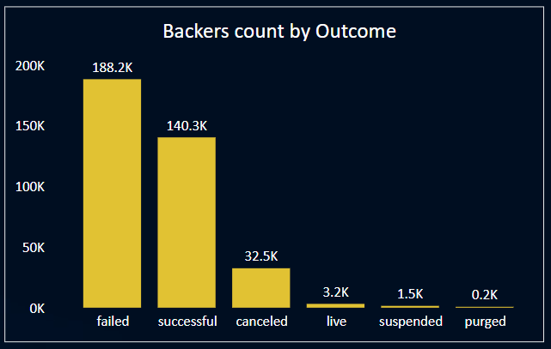
Project Overview
Out of 4.29 thousand total number of backers, Failed projects had the highest number of backers, with approximately 188.2 thousand backers.
Successful projects were backed by 140.3 thousand supporters. Whereas Cancelled projects had 32 thousand backers.
Live, suspended, and purged projects followed, with purged projects less than 200 backers.

Slide 14
Project Overview
The United States dominates in terms of the goal amount required by projects, accounting for a substantial 80% of the total.
Canada follows with 6%, reflecting a significantly lower contribution compared to the United States.
Britain, Japan, and Mexico each require 5% of the total goal amount, indicating a more balanced distribution among these countries.
The data highlights the prominent role of the United States in setting the goal amounts for projects, with other countries having comparatively smaller shares.

Slide 15
Successful Project Overview
Successful Projects
140,313
Total Backers
4,239
Total Pledged Amount
$3.479bn
Average Days
80.38 Days

Slide 16
Successful Project Overview
Here is a more detailed breakdown of each category:
Product Design is the most successful project category, representing 17.86% of the total successful projects.
Tabletop Games and Music follow closely with 12.52% and 12.18%, respectively.
Documentary projects account for 11.29% of the successful projects.
Video Games, Shorts, Food, Film and Video, and Fiction also contribute significantly to the success, ranging from one category to another.
Art is the least successful category, with only 6.36% of the total successful projects.

Slide 17
Successful Project Overview
Here is a more detailed breakdown of each category:
Successful projects show a significant increase over the years, with less than 0.4% completed in 2009.
The completion rate rises to 2.7% in 2010 and continues to climb to approximately 7% in 2011.
In 2012, the success rate further increases to around 11%, and a similar trend continues in 2013.
The highest success rate is observed in 2014, reaching 16.17% of total projects.
2015 follows closely with a success rate of 15.88%.
Success rates remain relatively high in 2016 at 12.62% and in 2017 at approximately 13%.
A slight decline is seen in 2018 with a success rate of about 10%.
In January 2019, the success rate drops back to 0.4%, reflecting a similar level to that of 2009.

Slide 18
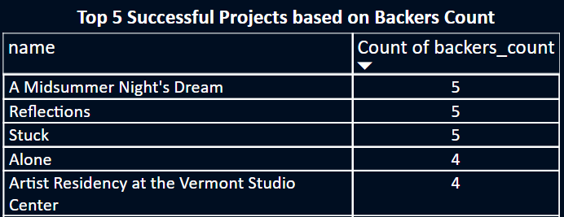
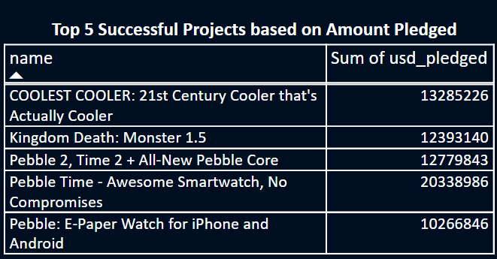
Top Successful Project

Slide 19
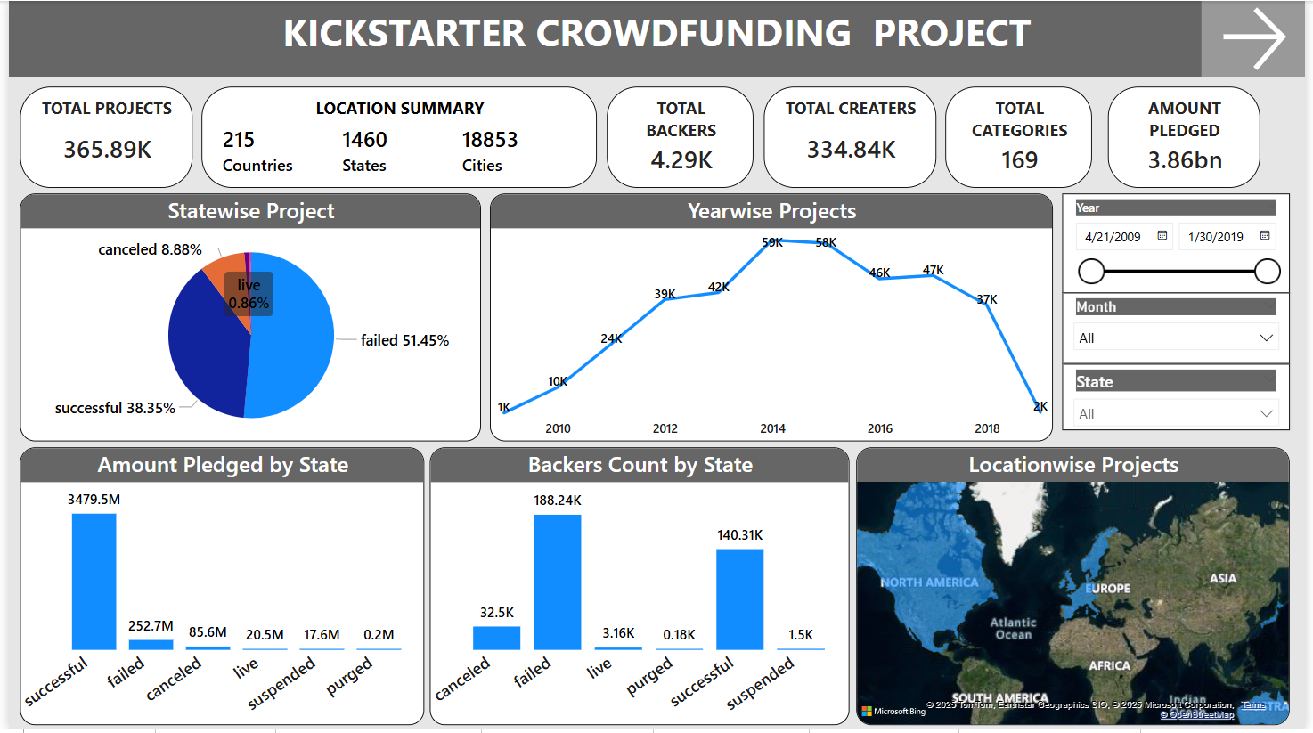
Power BI Dashboard

Slide 20
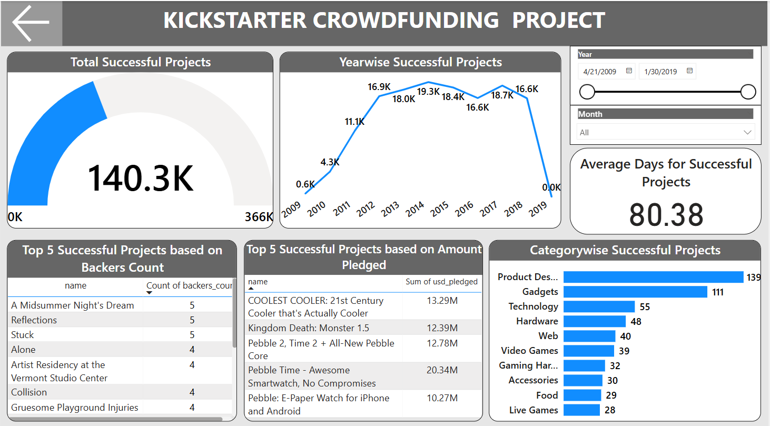
Power BI Dashboard

Slide 21
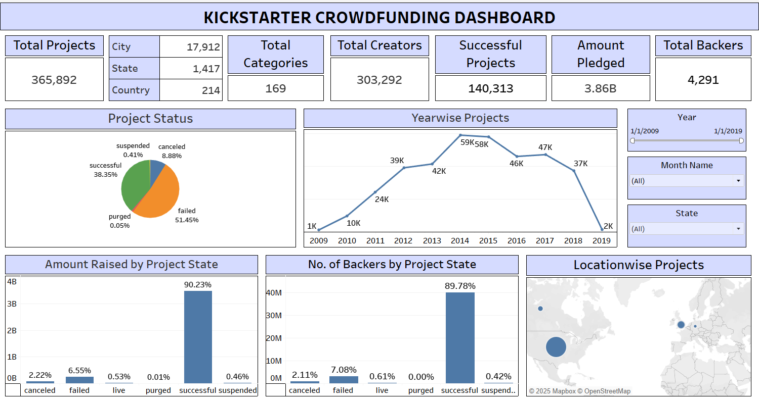
Tableau Dashboard

Slide 22
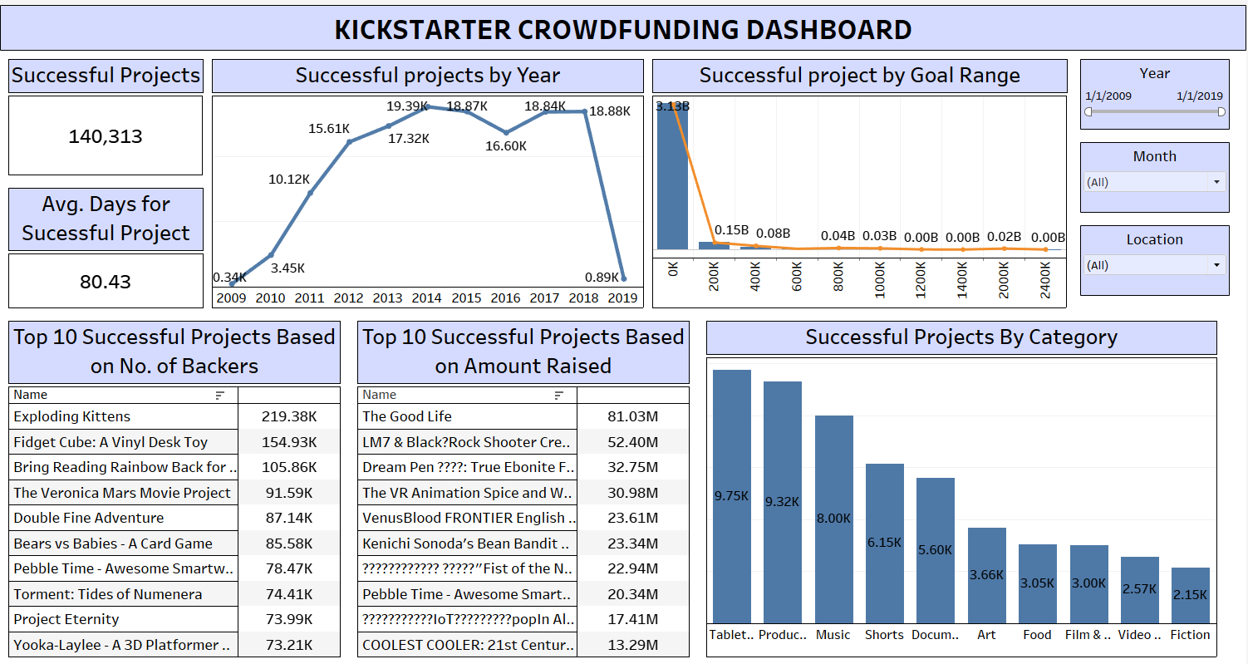
Tableau Dashboard

Slide 23
Conclusion
Geographic Focus: Concentrate on expanding beyond the United States, targeting areas with emerging creative industries to diversify project locations.
Category Emphasis: Prioritize marketing efforts on successful categories like Product Design, Tabletop Games, Music, and Documentary, exploring related niches within creative fields.
Trends and Seasonality: Acknowledge the steady increase in project creation over the years, with a peak in 2014. Plan resource allocation and marketing strategies, especially during peak times like Q4 and December.
Backer Engagement: Emphasize community engagement for project success, leveraging social media, and implementing strategies to increase backer involvement.
Monetary Success Metrics: Focus on optimizing project success rates, as successful projects account for the majority of funds. Enhance project appeal to improve overall chances of success.
Efficiency Metrics: Monitor and optimize Average Days to Completion to enhance project efficiency, positively influencing backer satisfaction and trust.
Category-Specific Strategies: Allocate resources based on historical success rates for different categories. Consider additional support for categories with lower success rates.
Global Expansion Opportunities: Explore opportunities to involve other countries beyond the dominant United States. Tailor strategies for potential growth markets with unique characteristics.
Continuous Innovation: Foster innovation within creative categories to maintain and increase market interest. Stay informed about emerging trends and technologies influencing project success.
Monitoring and Adaptation: Continuously monitor project success rates, backer engagement, and category trends. Be agile in adapting strategies based on evolving market dynamics and customer preferences.

Slide 24


